Slide 1
Biodiversity for the National Parks
Capstone Project
Introduction to Data Analysis Intensive Program
E. Reusi

Slide 2
ENDANGERED SPECIES

Slide 3
First things first…
5541
Different types of species
AMPHIBIAN
BIRD
FISH
Categories of species
MAMMAL
NONVASCULAR PLANT
REPTILE
VASCULAR PLANT
ENDANGERED
IN RECOVERY
NO INTERVENTION
Conservation statuses
SPECIES OF CONCERN
THREATENED

Slide 4
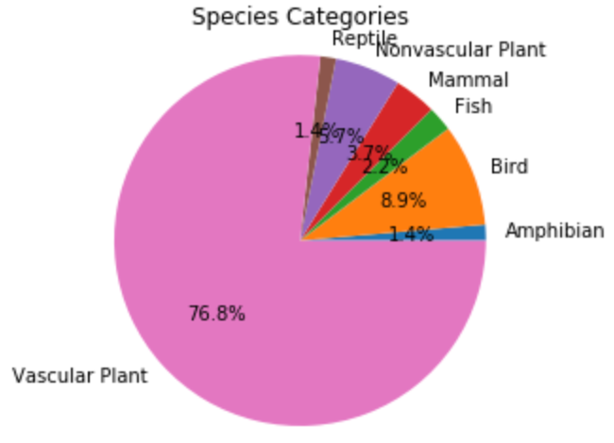
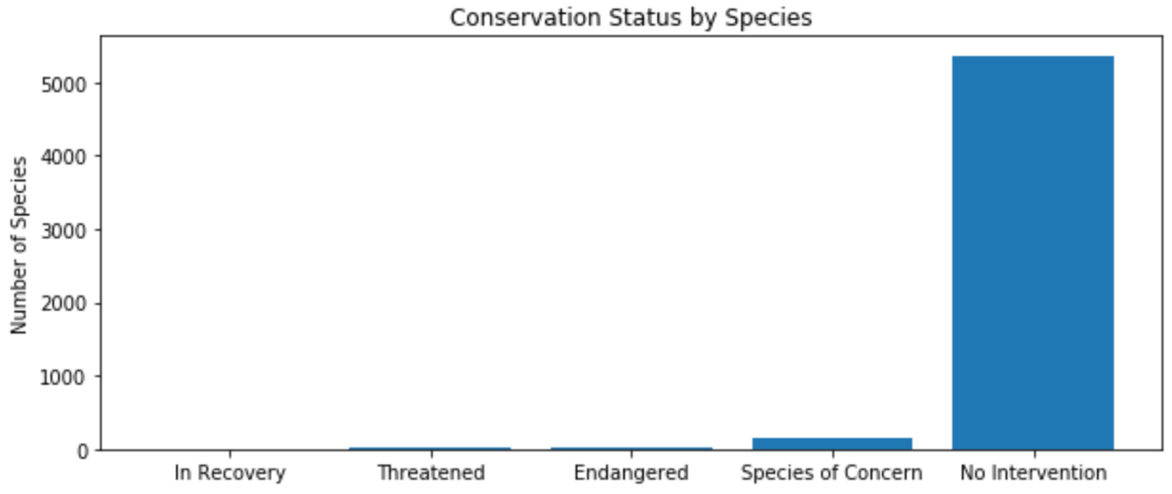
Categorization
> 76% of species in the park are vascular plants
> 96% of species in the park requires no intervention

Slide 5
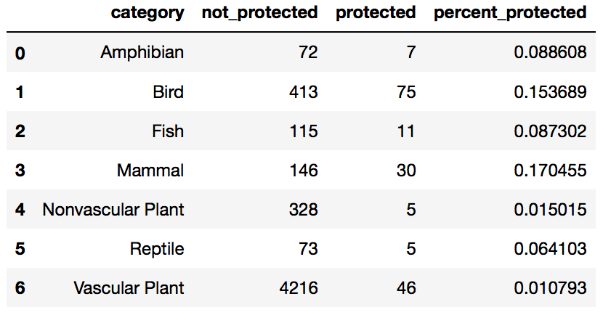
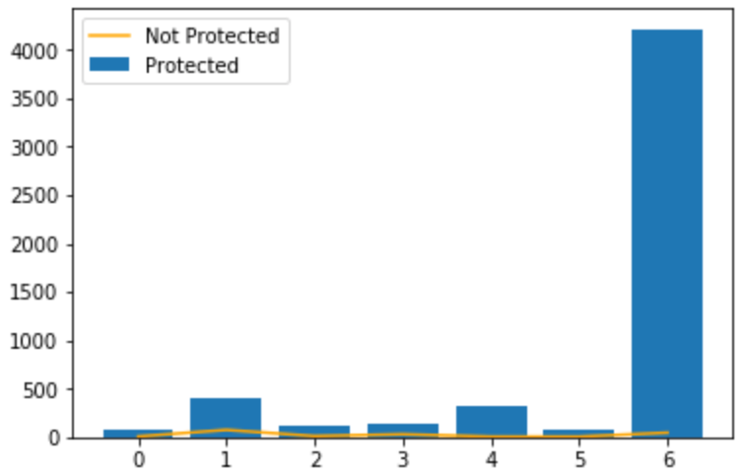
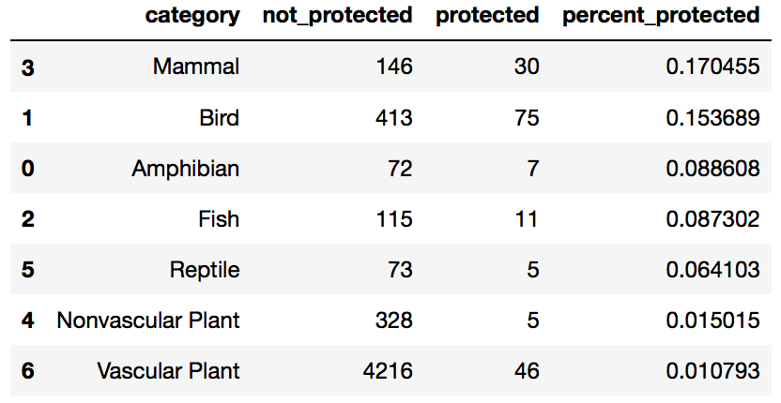
Protection by species
< 20% of each species are in need of protection
Relative to the number of species in each category, mammals have the highest protection percentage (most endangered), while vascular plants have the lowest.
*Data sorted by percent_protected

Slide 6
Are certain types of species more likely to be endangered?
Null hypothesis:
The difference in percentages is a result of chance.
If p-value > 0.05: accept null hypothesis, not significant, chance
If p-value < 0.05: reject null hypothesis, significant, not chance
Tested P-values:
Mammal vs Bird = 0.68759480966613362
Mammal vs Reptile = 0.038355590229698977
Bird vs Nonvascular Plant = 1.0546306904975004e-10
Amphibian vs Fish = 0.8247942981524834
All = 5.5108280473137505e-89
Majority of the tested p-values generated by performing the chi-squared test are greater than 0.05.
The difference between the protection percentage of most species is not significant and is a result of chance.
Certain types of species are more likely to be endangered than others.

Slide 7
Recommendation
Although we found that the difference between the protection percentage of most species is not significant and is a result of chance, there are still certain types of species that are more likely to be endangered than others.
It is therefore recommended to give the protection of these species higher priority and monitor their conservation status more closely.

Slide 8
FOOT & MOUTH DISEASE STUDY

Slide 9
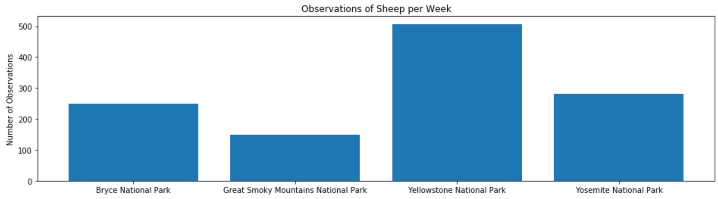
Observations of Sheep per Week

Slide 10
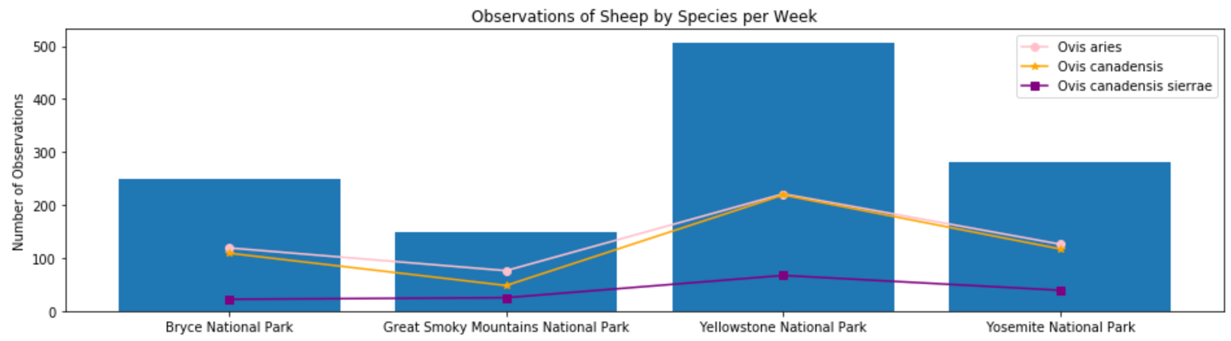
Observations of Sheep by Species per Week

Slide 11
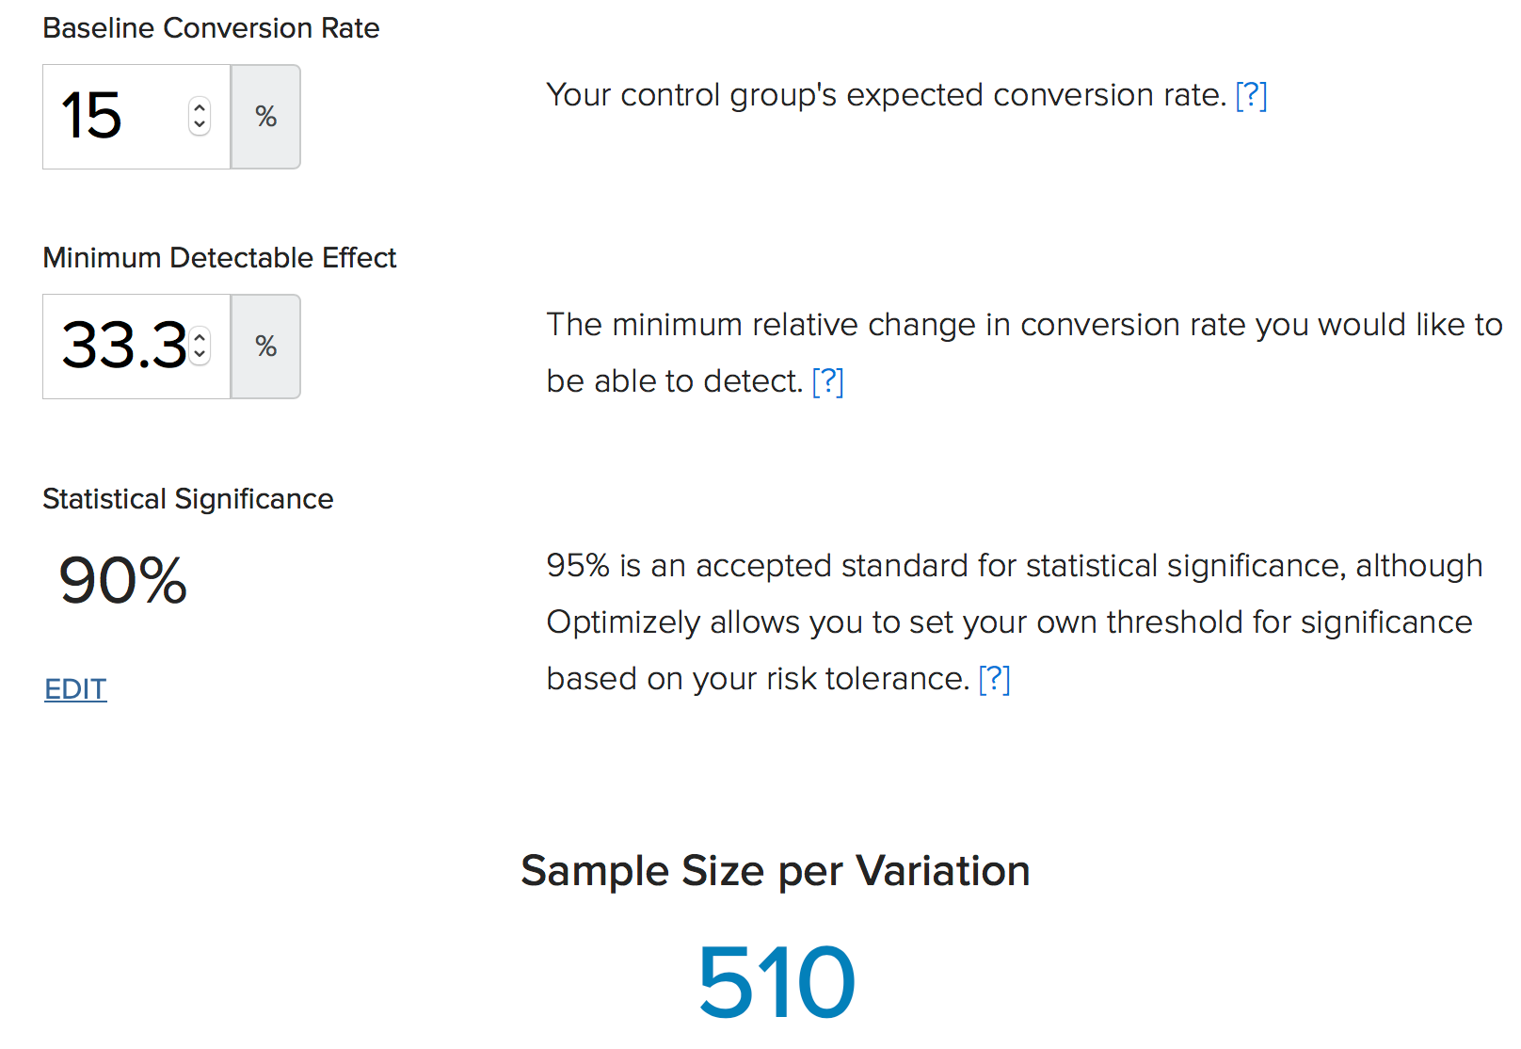
Sample Size Determination
Given a 15% occurrence of foot and mouth disease at Bryce National Park, park rangers at Yellowstone National Park will need to observe 510 sheep for approximately 1 week to make sure that there will be at least a 5% drop in observed cases.
Park rangers running the same program at Bryce National Park will have to observe the same number of sheep for about 2 weeks.

